Slide 1

Selected - 2
Number Team : 20

Slide 2
Faculty Name : Computers and artificial intelligence Helwan
Team members’ IDs and names.
.1محمد كمال عبدالحفيظ محمد202000812
.2مازن وحيد ربيع عويس202000708
.3علي سامي علي عبدالعزيز202000567
.4مصطفى محرم خليفة محمد202000908
.5احمد محمود حمادة محمود202000081
.6مصطفى حماده جمال محمد202000899

Slide 3
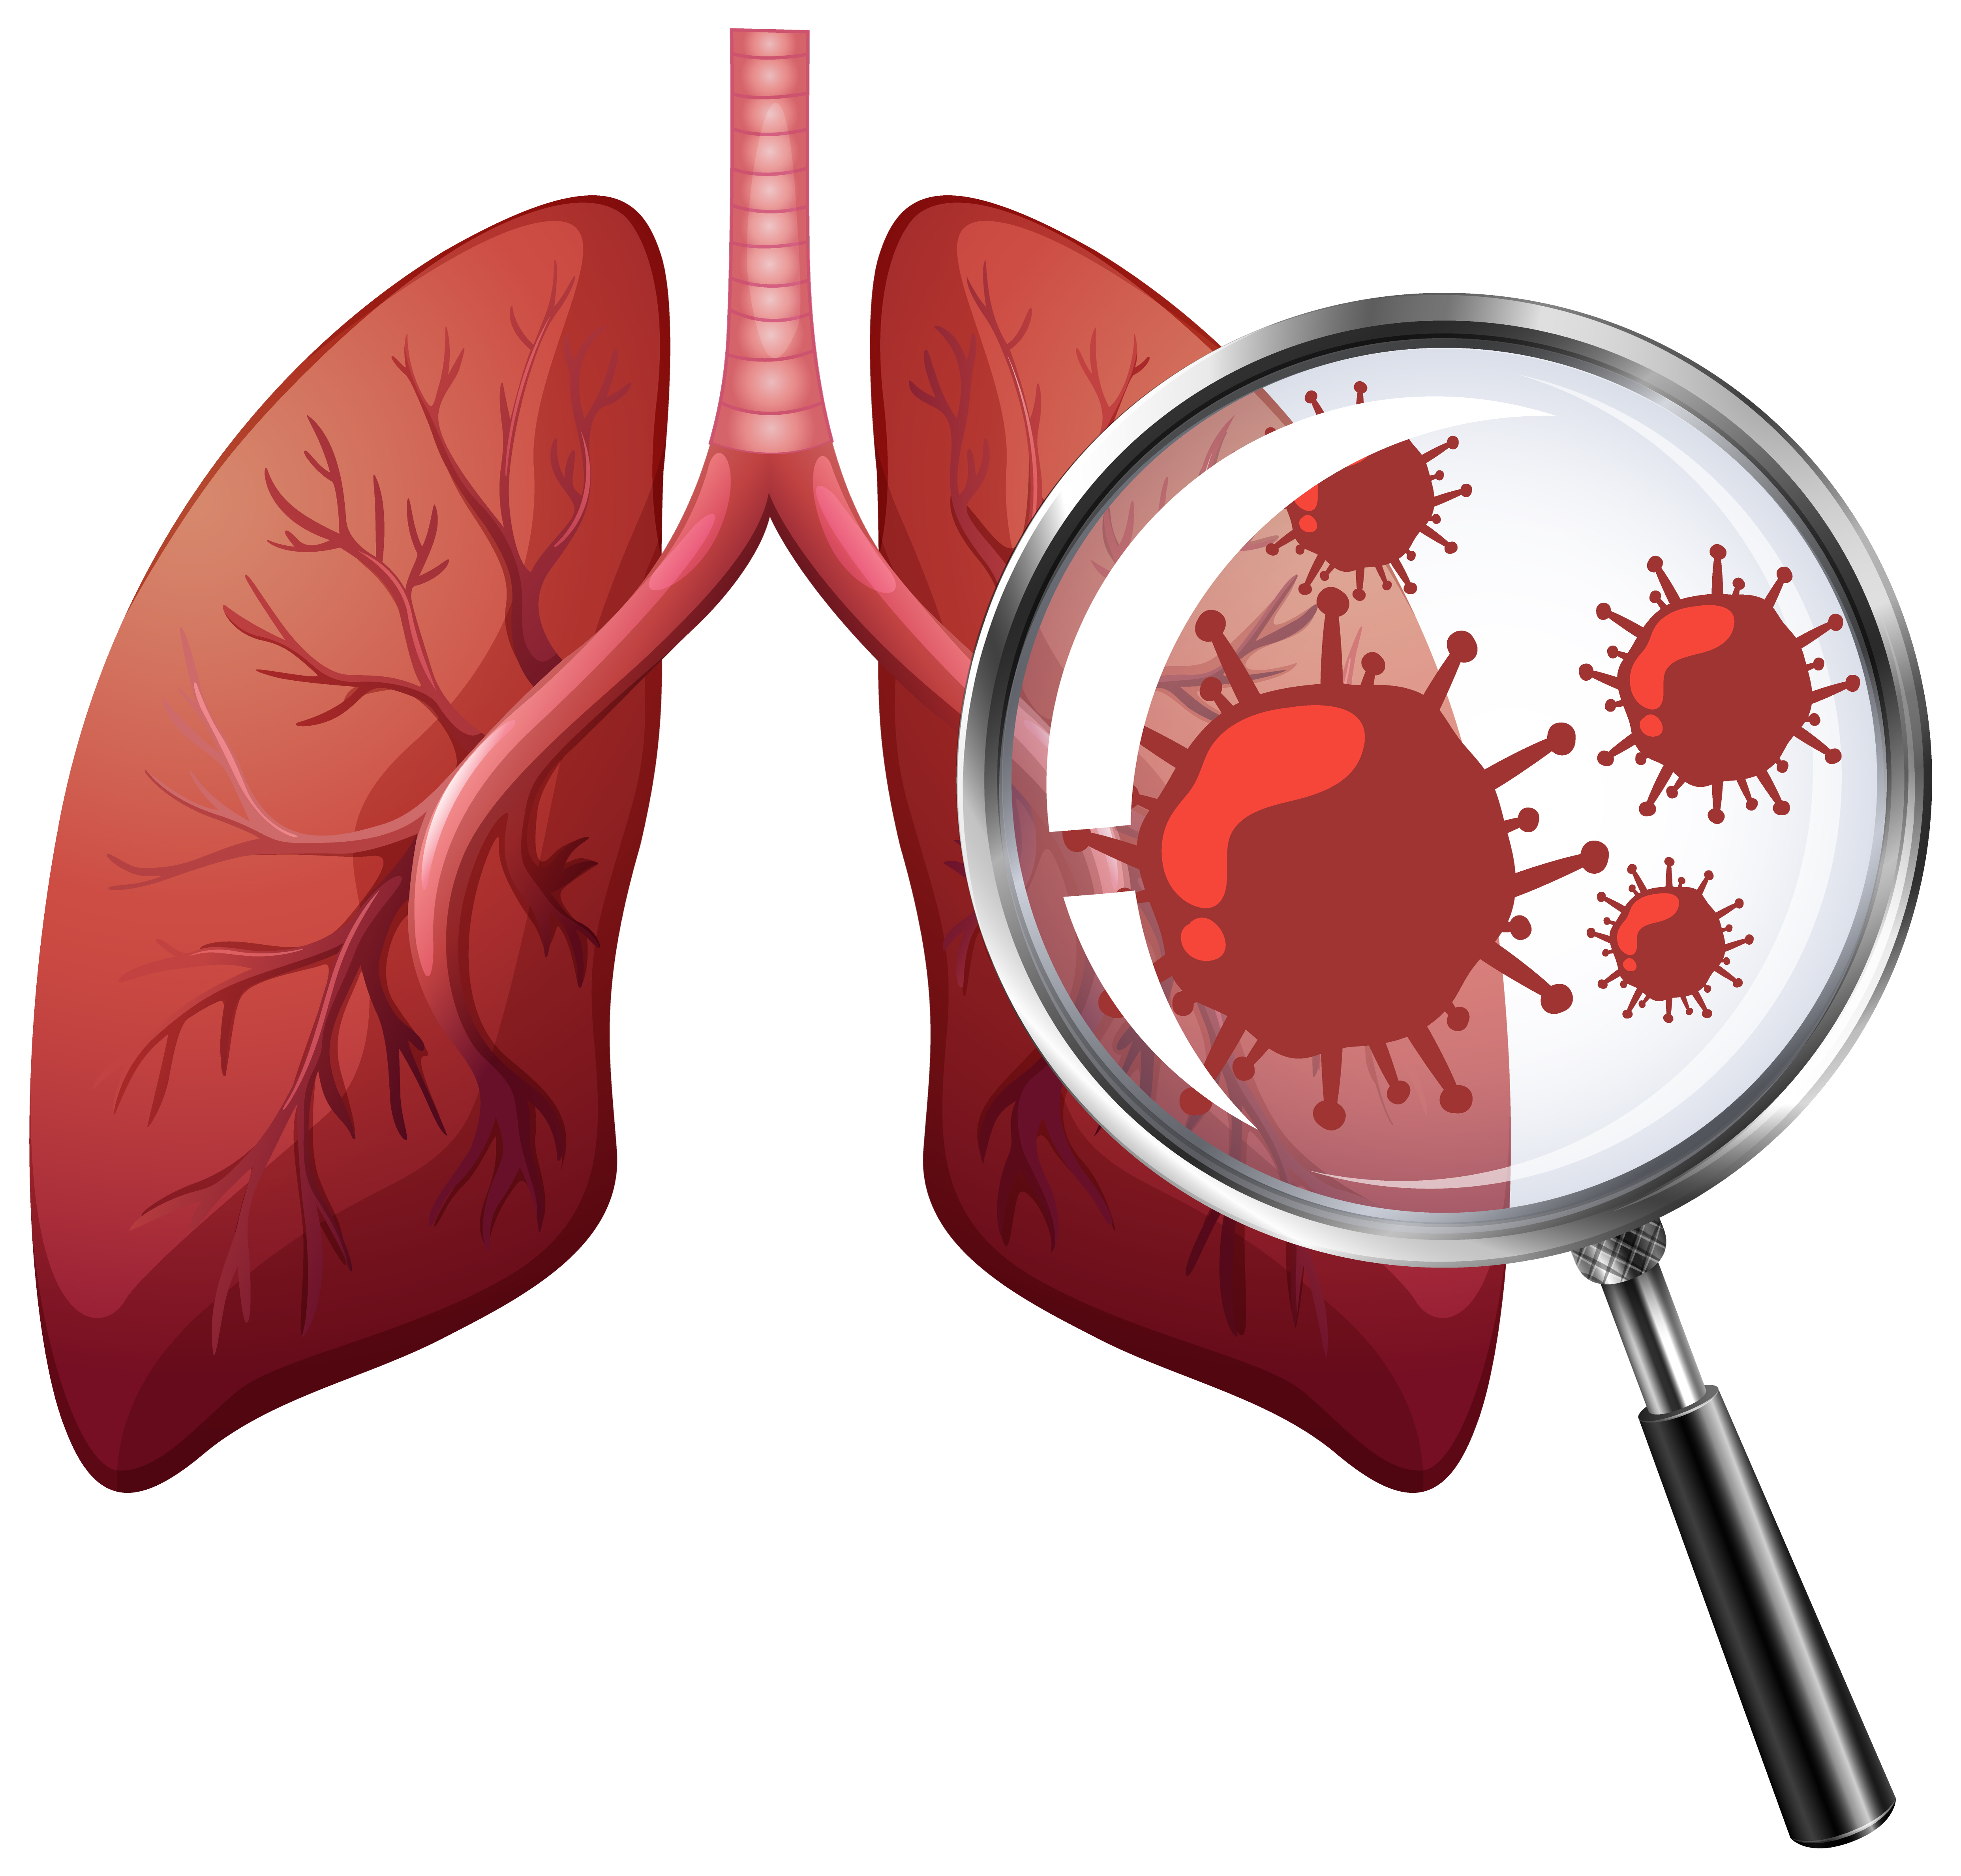
Paper details:
Authors name
1-Min Hong ,2- Beanbonyka Rim , 3-Hong‐Chang Lee ,
4-Hyeon‐ung Jang ,5- Joonho Oh ,6- Seongjun Choi
paper name
Multi‐Class Classification of Lung Diseases Using CNN Models
year of publication
October 2021
The dataset used
Chest X-Ray Images (Pneumonia)
the implemented algorithms
EfficientNet‐B0
VGG‐D

Slide 4
Project Description Document
the name of the dataset
Multi‐Class Classification of Lung Diseases Using CNN Models
the link of dataset
https://www.kaggle.com/datasets/paultimothymooney/chest-xray-pneumonia
the total number of samples in the dataset
13,977
the dimension of images
640*640
number of classes and their labels
Two classes (0,1)
1-Normal 2- Pneumonia

Slide 5
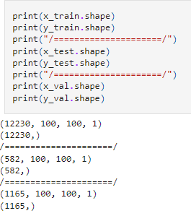
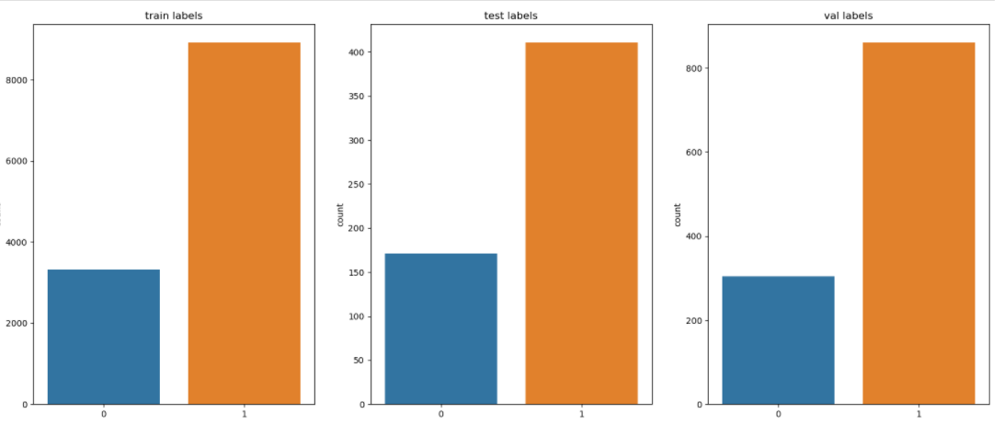
Implementation Details:
Ratio for
number of images
Training :
validation:
testing:
Training : 12230
validation:1165
testing: 582
87.5
8.3
4.2

Slide 6
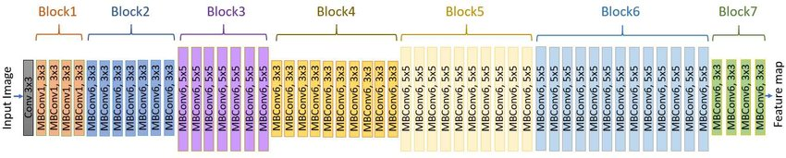
block diagram

Slide 7
Hyperparameters used:
Activation= relu ,softmax
lambda
lambda layer to convert gray images to RGB image
learning_rate=0,0001
Optimizer:adam
Batch_size=128
epochs=10

Slide 8
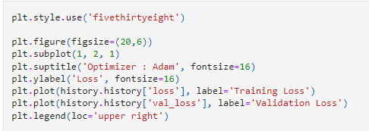
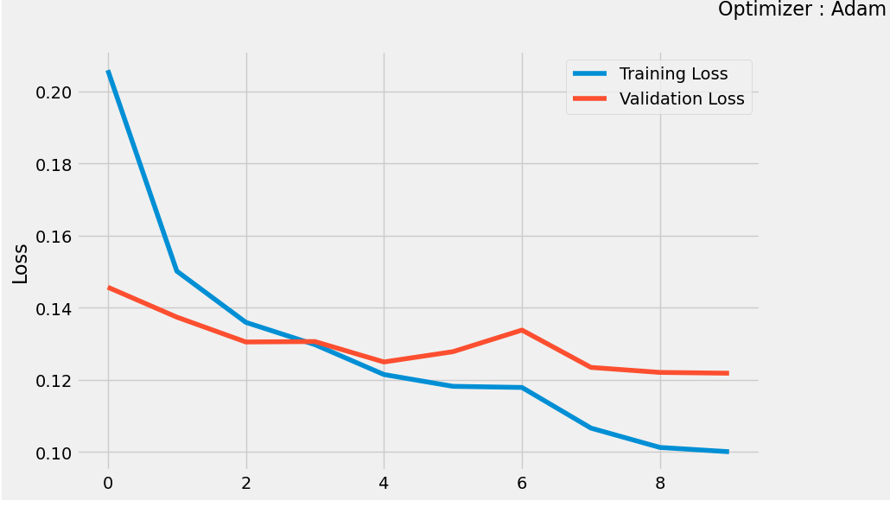
Results Details:
1 - Training Loss & Validation Loss

Slide 9
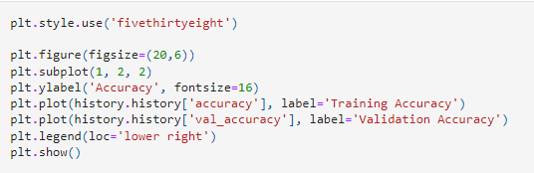
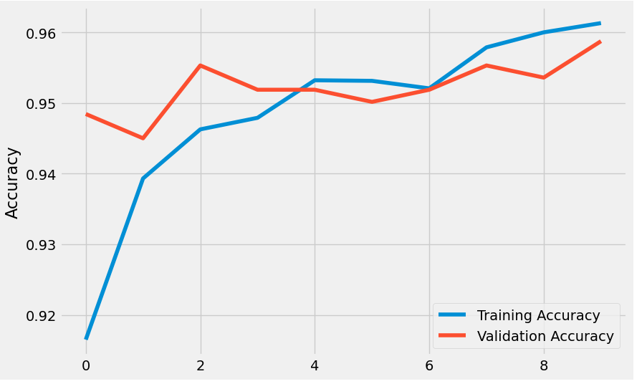
2 - Taining Accuracy & Validation Accuracy

Slide 10
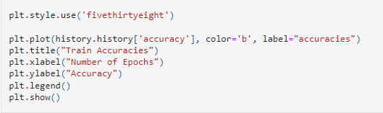
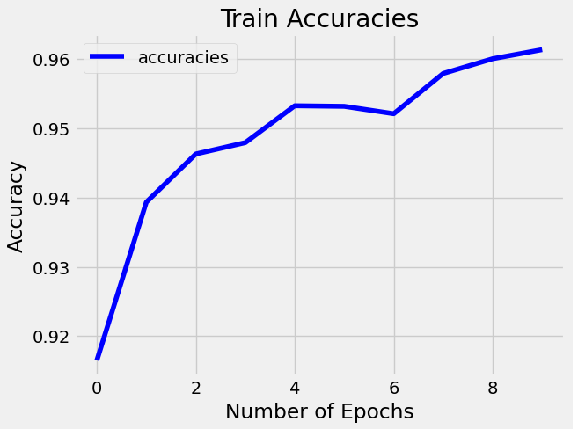
3 - Train Accuracies

Slide 11
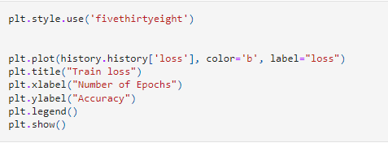
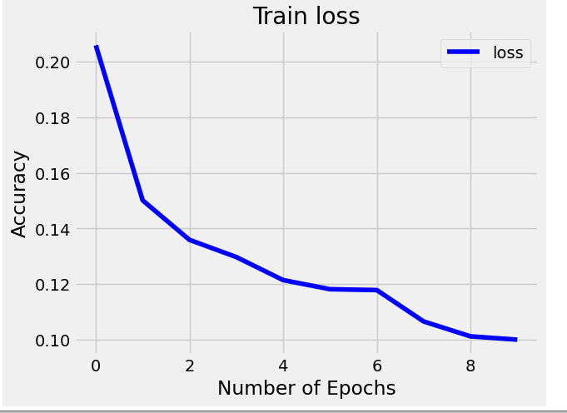
4 - Train Loss

Slide 12
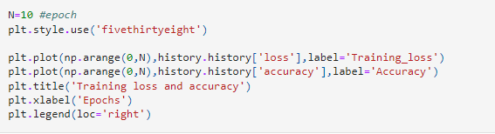
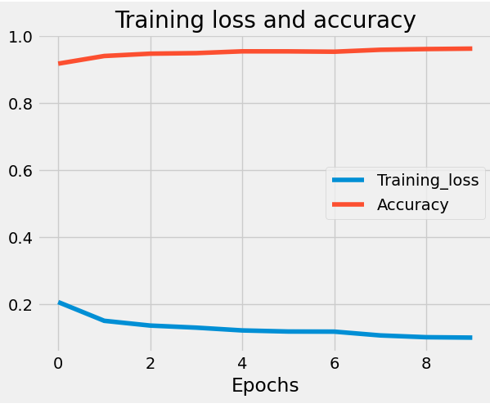
5 - Training Loss & Accuracy

Slide 13
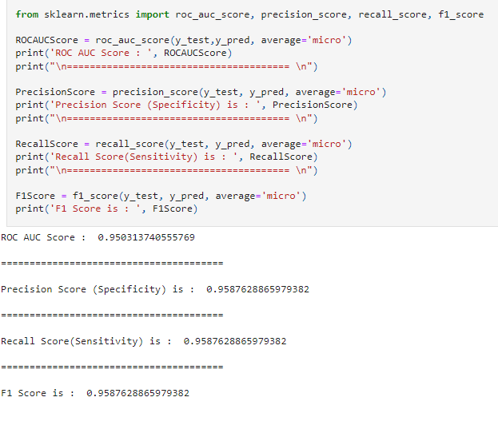
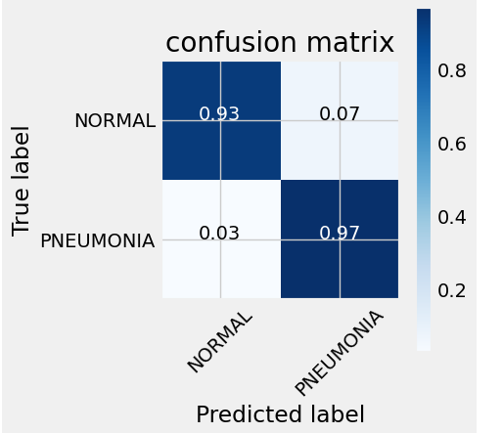
1. Confusion Matrix:

Slide 14
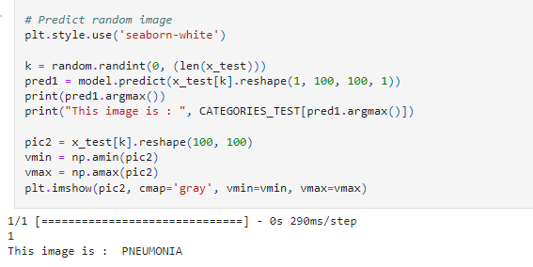
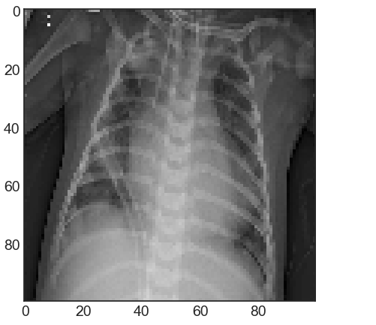
Prediction

Slide 15

Thank you

